Slide 1
THE GURU IN THE SIKH
THE GURU IN THE SIKH

Slide 2
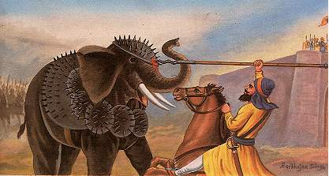
This transformation comes not only through close association with the Guru, which is found in many other religions, but through the belief that the Sikh incorporates the Guru.
He fills himself with the Guru and then feels himself linked up with an inexhaustible source of power.
A Sikh, a pure-hearted Sikh, who follows the teachings of his Guru is a great power in himself; but when such a Sikh gets into himself the dynamic personality of such a perfect example as Guru Gobind Singh, his powers acquire an infinite reach and he becomes a super-man.
Blessed by Guru GOBIND singh bhai Bachitar singh like superman facing drunk armored elephant with nagni a spear

Slide 3
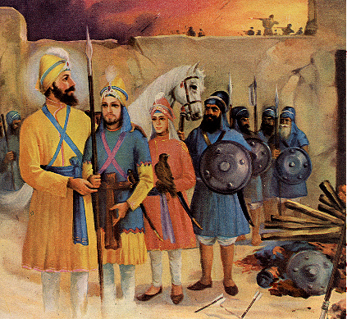
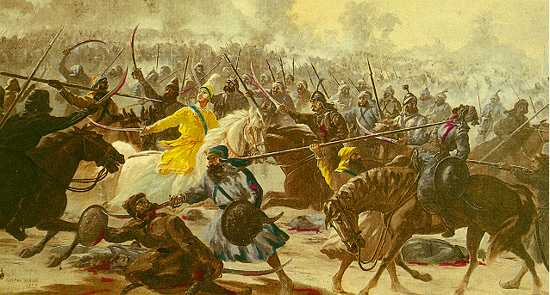
He is called Khalsa, the personification of the Guru himself. “The Khalsa” says the Guru, “is my other self’ in him I live and have my being.”
A single Sikh, a mere believer, is only one; but the equation changes when he takes Guru Gobind Singh into his embrace.
He becomes equal to ‘one lakh and a quarter,’ in the Sikh parlance.
This change occurs not only in his physical fitness, but also in his mental and spiritual outlook.
Forty sikhs facing 10 lakh mughal army
At chamkaur sahib

Slide 4
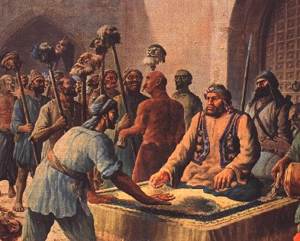
His nature is so reinforced in every way that although hundreds may fall round him, he will resist to the last and never give way.
Wherever he stands, he will stand as ‘a garrison of the Lord of Hosts,’ a host in himself - a host of one lakh and a quarter.
He will keep the Guru’s flag always flying. Whenever tempted, he will ask himself, “Can I lower the flag of Guru Gobind Singh? Can I desert it?
I, as Budh Singh or Kahan Singh, can fall; but can Guru Gobind Singh in me fall? No, never.”
Sikhs never give way to temptation
Or coercion

Slide 5
This feeling of incorporation with the Guru makes the Sikh strong beyond his ordinary powers and in times of emergency comes to his rescue long before he can remember anything relevant to the occasion recorded in history or scripture.
Bhai Joga Singh’s case is just in point. He was a devoted Sikh of Guru Gobind Singh, and had received Amrit from the hands of the Guru himself.
He was so loyal that when he received an urgent call from the Guru to proceed to Anandpur , he hastened from Peshawar without a moment’s delay, not waiting even to see his own marriage through.

Slide 6
And yet in a moment of weakness, this paragon of Sikh purity was going to fall, fall at the door of a public woman of Hoshiarpur.
Who saved him in that emergency?
It was the vision of Guru Gobind Singh, re-establishing the personal contact by pointing out the signs of personation worn on his body, and reminding him that he was carved in the Guru’s own image.

